Slide 1

Warby Parker
Learn SQL from Scratch
Chelsie Petras
October 20, 2018

Slide 2
Table of Contents
Quiz Funnel
Home Try-On Funnel
Actionable Insights

Slide 3
1.1 Quiz Funnel
To help users find their perfect frame, Warby Parker has a Style Quiz that has the following questions:
"What are you looking for?"
"What's your fit?"
"Which shapes do you like?"
"Which colors do you like?"
"When was your last eye exam?”
The users' responses are stored in a table called survey.
Column 1 | Column 2 | Column 3
Question | User_ID | Response
-- Quiz Funnel
SELECT *
FROM survey
LIMIT 10;

Slide 4
1.2 Quiz Funnel
Users will "give up" at different points in the survey. Let's analyze how many users move from Question 1 to Question 2, etc.
Create a quiz funnel using the GROUP BY command.
What is the number of responses for each question?
-- Quiz Funnel
SELECT question,
COUNT(DISTINCT user_id)
FROM survey
GROUP BY 1;
Question | Count
1. What are you looking for? | 500
2. What's your fit? | 475
3. Which shapes do you like? | 380
4. Which colors do you like? | 361
5. When was your last eye exam? | 270

Slide 5
1.3 Quiz Funnel
Using a spreadsheet program like Excel or Google Sheets, calculate the percentage of users who answer each question:
Which question(s) of the quiz have a lower completion rates?
Question 5 has the lowest completion rate, followed by questions 4 then 5.
What do you think is the reason?
It can be difficult to remember when your last eye exam was because it’s an exact date, where as the other questions are based on your personal preference, which is easier to answer on the spot.
Question | Count (DISTINCT) | Completion Rate (%)
1. What are you looking for? | 500 | 100.00%
2. What's your fit? | 475 | 95.00%
3. Which shapes do you like? | 380 | 76.00%
4. Which colors do you like? | 361 | 72.20%
5. When was your last eye exam? | 270 | 54.00%

Slide 6
2.1 Home Try-On Funnel
Let's find out whether or not users who get more pairs to try on at home will be more likely to make a purchase.
The data will be distributed across three tables:
Quiz, home_try_on, and purchase
Examine the first five rows of each table
What are the column names?
quiz
user_id | style | fit | shape | color
Home_try_on
user_id | number_of_pairs | address
purchase
user_id | product_id | style | model_name | color | price

Slide 7
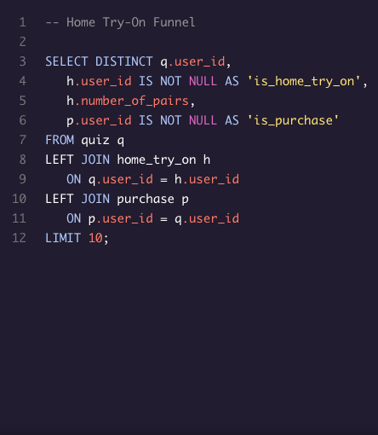
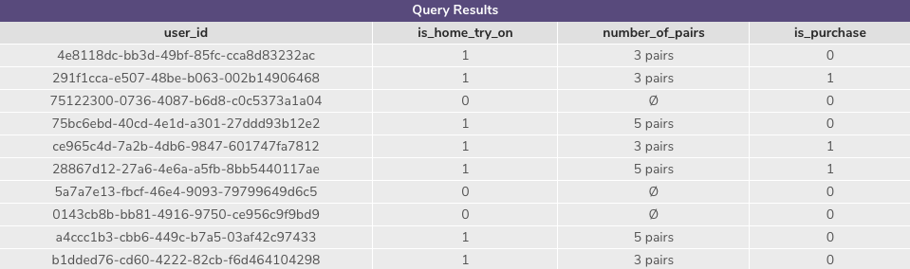
2.2 Home Try-On Funnel
Each row will represent a single user from the browse table:
If the user has any entries in home_try_on, then is_home_try_on will be 'True'.
number_of_pairs comes from home_try_ontable
If the user has any entries in is_purchase, then is_purchase will be 'True'.
Use a LEFT JOIN to combine the three tables, starting with the top of the funnel (browse) and ending with the bottom of the funnel (purchase).

Slide 8
3.1 Actionable Insights

